Slide 1

Lecture 01
Web Application (In)security
CNC 3304 Web Security
Notes:
Case study – KIU LMS hack – even students and lecturers got a hard time because of this attack.
Case study 2 - https://www.securityweek.com/millions-of-user-records-stolen-from-65-websites-via-sql-injection-attacks/

Slide 2
The Evolution of Web Applications
Early Days of the Internet
  The World Wide Web consisted of static websites, serving as information repositories.
  Web browsers were developed to retrieve and display these documents.
  Information flow was one-way: server → browser.
  Most sites did not authenticate users; all users were treated equally.
  Content was uniformly displayed to all users without personalization.
  Security threats were largely due to vulnerabilities in web server software.
  Common Attacker Goals:
    Modify files on servers to deface content.
    Use server resources (e.g., storage, bandwidth) to distribute “warez.”
  Sensitive information was not at risk because all data was already public.

Slide 3
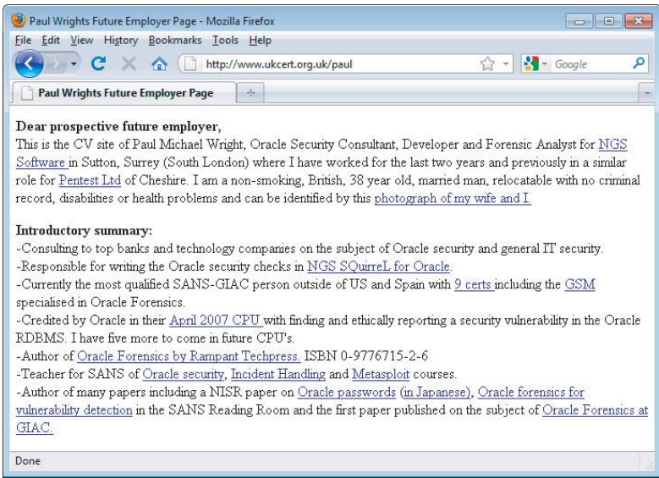
A traditional website containing static information

Slide 4
Modern Web Applications
The web is now dominated by applications, not static websites.
Applications enable a two-way flow of information between servers and browsers.
They support registration and login, financial transactions, search, and the authoring of content by users.
The content is generated dynamically on the fly and is often tailored to each specific user.
Much of the information processed is private and highly sensitive.
Security is a big issue.
Eg: Today, you can visit a web application and perform a fund transfer yourself.
An attacker who compromises a web application may be able to steal personal information, carry out financial fraud, and perform malicious actions against other users.

Slide 5
Common Web Application Functions
Shopping (Amazon)
Social networking (Facebook)
Banking (Citibank)
Web search (Google)
Auctions (eBay)
Gambling (Betfair)
Web logs (Blogger)
Web mail (Gmail)
Interactive information (Wikipedia)
In addition to the public Internet, web applications have been widely adopted inside organizations to support key business functions. (eg: HR apps, ERP, MS office live)
Notes:
enterprise resource planning (ERP)

Slide 6
Web Application Security
“This Site Is Secure”
Most applications state that they are secure because they use SSL/compliance with a standard.
Eg:
“This site is absolutely secure. It has been designed to use 128-bit Secure Socket Layer (SSL) technology to prevent unauthorized users from viewing any of your information. You may use this site with peace of mind that your data is safe with us.”
“We take security very seriously. Our web site is scanned daily to ensure that we remain PCI compliant and safe from hackers. You can see the date of the latest scan on the logo below, and you are guaranteed that our web site is safe to use.”
In fact, the majority of web applications are insecure, despite the widespread usage of SSL technology and the adoption of standards like PCIDSS.

Slide 7
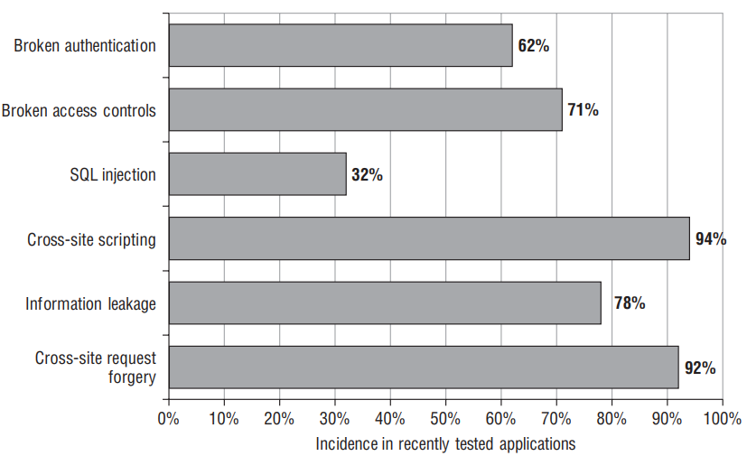
The incidence of some common web application vulnerabilities in applications tested during 2007 and 2011.
Notes:
The authors of The Web Application Hacker's Handbook have tested hundreds of web applications in recent years. Figure shows what percentage of applications tested during 2007 and 2011 were found to be affected by some common categories of vulnerability.

Slide 8
SSL is an excellent technology that protects the confidentiality and integrity of data in transit between the user’s browser and the web server.
It can help defend against eavesdroppers, and it can provide assurance to the user of the identity of the web server he is dealing with.
But it does not stop attacks that directly target the server or client components of an application, as most successful attacks do.
Regardless of whether they use SSL, most web applications still contain security flaws.

Slide 9
The Core Security Problem: Users Can Submit
Arbitrary Input
Fundamental problem web apps must address to be secure - Users can submit arbitrary input to the server-side application, because the client is outside of application’s control.
The application must assume that all input is potentially malicious.
Therefore, it must take steps to ensure that attackers cannot use crafted input to compromise the application by interfering with its logic and behaviour, thus gaining unauthorized access to its data and functionality.

Slide 10
This core problem manifests itself in various ways:
Users can interfere with any piece of data transmitted between the client and the server, including request parameters, cookies, and HTTP headers. Any security controls implemented on the client side, such as input validation checks, can be easily circumvented.
Users can send requests in any sequence and can submit parameters at a different stage than the application expects, more than once, or not at all. Any assumption developers make about how users will interact with the application may be violated.
Users are not restricted to using only a web browser to access the application. Numerous widely available tools operate alongside, or independently of, a browser to help attack web applications. These tools can make requests that no browser would ordinarily make and can generate huge numbers of requests quickly to find and exploit problems.

Slide 11
The majority of attacks against web applications involve sending input to the server that is crafted to cause some event that was not expected or desired by the application’s designer.
Eg:
Changing the price of a product transmitted in a hidden HTML form field to fraudulently purchase the product for a cheaper amount.
Modifying a session token transmitted in an HTTP cookie to hijack the session of another authenticated user.
Removing certain parameters that normally are submitted to exploit a logic flaw in the application’s processing.
Altering some input that will be processed by a back-end database to inject a malicious database query and access sensitive data.

Slide 12
Key Problem Factors
Underdeveloped Security Awareness
Although awareness of web application security issues has grown in recent years, it remains less well-developed than in longer-established areas such as networks and operating systems.
Although most people working in IT security have a reasonable grasp of the essentials of securing networks and hardening hosts, widespread confusion and misconception still exist about many of the core concepts involved in web application security.
Developers frequently integrate tens or hundreds of third-party libraries or packages. These abstractions simplify development but obscure the underlying technologies and their security implications.
It is common to meet experienced web application developers who make major assumptions about the security provided by their programming framework and to whom an explanation of many basic types of flaws comes as a revelation.
Notes:
The Equifax Data Breach - Equifax, a credit reporting agency, suffered a massive breach due to an unpatched vulnerability in Apache Struts, a third-party framework used in its web application.
A severe vulnerability (Log4Shell) was discovered in Log4j, a popular Java-based logging library. Many organizations were caught off-guard because they didn’t realize their systems relied on this library.

Slide 13
Key Problem Factors cont.
Custom Development
Most web applications are developed in-house by an organization’s own staff or third-party contractors.
Even where an application employs well-established components, these are typically customized or bolted together using new code.
In this situation, every application is different and may contain its own unique defects.
This stands in contrast to a typical infrastructure deployment, in which an organization can purchase a best-of-breed product and install it in line with industry-standard guidelines.
Notes:
Many hospitals have custom-built electronic medical record (EMR) systems tailored to their specific needs. These systems often suffer from unique bugs or compatibility issues because of custom code or third-party integrations.
In contrast, organizations using standardized, off-the-shelf EMR systems (like Epic or Cerner) benefit from well-tested, industry-compliant solutions.

Slide 14
Key Problem Factors cont.
Deceptive Simplicity
With today’s web application platforms and development tools, it is possible for a novice programmer to create a powerful application from scratch in a short period of time.
There is a huge difference between producing code that is functional and code that is secure.
Many web applications are created by well meaning individuals who simply lack the knowledge and experience to identify where security problems may arise.
Use of application frameworks (eg: Liferay, Appfuse) that provide ready-made code components to handle numerous common areas of functionality: These products make it quick and easy to create working applications without requiring a technical understanding of how the applications work or the potential risks they may contain. This also means many companies use the same frameworks. So, when a vulnerability is discovered, it affects many unrelated applications.
Notes:
Scenario: Modern cars are so automated that anyone can drive one without knowing how the engine, brakes, or transmission work. However, if something goes wrong, the driver won't know how to fix it or even recognize the warning signs of an impending issue.
Connection: Development frameworks let developers "drive" their applications (create functionality) without understanding the underlying "engine" (codebase). This lack of technical understanding makes it hard to identify and fix vulnerabilities.
WordPress is one of the most popular content management systems, used by millions of websites. Its ease of use allows even non-technical users to create functional websites. However, vulnerabilities in WordPress core, plugins, or themes can lead to widespread exploitation. For example, the RevSlider plugin vulnerability was used in several attacks, impacting thousands of WordPress sites.

Slide 15
Key Problem Factors cont.
Rapidly Evolving Threat Profile
Research into web application attacks and defenses continues to be a thriving area in which new concepts and threats are conceived at a faster rate than is now the case for older technologies.
Particularly on the client side, it is common for the accepted defenses against a particular attack to be undermined by research that demonstrates a new attack technique.
A development team that begins a project with a complete knowledge of current threats may have lost this status by the time the application is completed and deployed.
Notes:
How to stay up-to-date with current threats?
Cyber threat intelligence

Slide 16
Key Problem Factors cont.
Resource and Time Constraints
Most web application development projects are subject to strict constraints on time and resources, arising from the economics of in-house, one-off development.
In most organizations, it is often infeasible to employ dedicated security expertise in the design or development teams. And due to project slippage, security testing by specialists is often left until very late in the project’s life cycle.
In the balancing of competing priorities, the need to produce a stable and functional application by a deadline normally overrides less tangible security considerations.
A typical small organization may be willing to pay for only a few man-days of consulting time to evaluate a new application. A quick penetration test will often find the low-hanging fruit, but it may miss more subtle vulnerabilities that require time and patience to identify.
Notes:
A typical small business might outsource web development to save costs and set tight deadlines to launch their application. They allocate minimal resources for security testing, often opting for a quick, budget-friendly penetration test. As a result, only basic vulnerabilities are identified, leaving the application exposed to advanced attacks.

Slide 17
Key Problem Factors cont.
Overextended Technologies
Many of the core technologies employed in web applications began life when the landscape of the World Wide Web was very different.
They have since been pushed far beyond the purposes for which they were originally conceived, such as the use of JavaScript as a means of data transmission in many AJAX-based applications.
As the expectations placed on web application functionality have rapidly evolved, the technologies used to implement this functionality have lagged behind the curve, with old technologies stretched and adapted to meet new requirements. Unsurprisingly, this has led to security vulnerabilities as unforeseen side effects emerge.
Notes:
Scenario: A vintage car is retrofitted with modern features like GPS, automatic locks, and electric windows. While functional, the car's original design wasn't built to handle these upgrades, which may cause compatibility issues or breakdowns.
Connection: Similarly, technologies like JavaScript and HTML, originally created for static content, are now adapted to power highly interactive applications. This stretching of capabilities introduces vulnerabilities because the foundations weren’t designed with today’s needs in mind.
Cookies were originally designed to store simple session data for user convenience. Over time, they became a key mechanism for authentication, tracking, and personalized user experiences. This overextension introduced vulnerabilities like session fixation and cookie theft, especially before the widespread adoption of secure flags like HttpOnly and Secure.

Slide 18
Key Problem Factors cont.
Increasing Demands on Functionality
Applications are designed primarily with functionality and usability in mind.
Once-static user profiles now contain social networking features, allowing uploading of pictures and wiki-style editing of pages.
A few years ago an application designer may have been content with implementing a username and password challenge to create the login functionality.
Modern sites may include password recovery, username recovery, password hints, and an option to remember the username and password on future visits.
Such a site would undoubtedly be promoted as having numerous security features, yet each one is really a self service feature adding to the site’s attack surface.
Notes:
Facebook's password recovery feature allows users to reset their passwords through email or SMS. While this feature enhances usability, attackers have exploited it in phishing campaigns to intercept recovery codes or gain access through weak recovery mechanisms.
Many modern applications allow users to upload profile pictures or documents. However, attackers often exploit these features to upload malicious files, such as web shells, if proper validation is not in place.

Slide 19
The New Security Perimeter
Before web applications, organizations’ efforts to secure themselves against external attack were largely focused on the network perimeter. Defending this perimeter entailed hardening and patching the services it needed to expose and firewalling access to others.
Web applications have changed all this.
For an application to be accessible by its users, the perimeter firewall must allow inbound connections to the server over HTTP or HTTPS. And for the application to function, the server must be allowed to connect to supporting back-end systems, such as databases, mainframes, and financial and logistical systems. These systems often lie at the core of the organization’s operations and reside behind several layers of network-level defenses.
If a vulnerability exists within a web application, an attacker on the public Internet may be able to compromise the organization’s core back-end systems solely by submitting crafted data from his web browser. This data sails past all the organization’s network defenses, in the same way as does ordinary, benign traffic to the web application.
Notes:
Network diagram

Slide 20
The New Security Perimeter cont.
Eg:
suppose that an attacker wants to “hack in” to a bank’s systems and steal money from users’ accounts. In the past, before the bank deployed a web application, the attacker might have needed to find a vulnerability in a publicly reachable service, exploit this to gain a foothold on the bank’s DMZ, penetrate the firewall restricting access to its internal systems, map the network to find the mainframe computer, decipher the arcane protocol used to access it, and guess some credentials to log in.
However, if the bank now deploys a vulnerable web application, the attacker may be able to achieve the same outcome simply by modifying an account number in a hidden field of an HTML form.
Notes:
An arcane protocol refers to a complex, obscure, or outdated communication protocol used to interact with a specific system, such as a mainframe. arcane protocol is the specialized method the bank's mainframe uses to communicate, which would require significant effort for the attacker to understand and exploit.

Slide 21
The Future of Web Application Security
The details of the web application security landscape are not static. Even though old and well-understood vulnerabilities such as SQL injection continue to appear, their prevalence is gradually diminishing. Furthermore, the instances that remain are becoming more difficult to find and exploit.
Attacks have moved from targeting the server side of applications to targeting users of the application. It still leverages defects within the application itself, but it generally involves some kind of interaction with another user to compromise that user’s dealings with the vulnerable application.
As awareness of security threats matures, flaws in the server side are the first to be well understood and addressed, leaving the client side as a key battleground as the learning process continues.
Notes:
Early web security revolved around protecting servers. SQL injection, command injection, and buffer overflow attacks dominated because they directly targeted server logic and data.
As server-side security matured (with frameworks enforcing input validation and prepared statements), attackers pivoted to targeting users via flaws like:
Cross-Site Scripting (XSS): Injecting malicious scripts into web pages that execute in a user’s browser.
Cross-Site Request Forgery (CSRF): Trick users into performing unwanted actions (e.g., transferring money).
Social Engineering + App Flaws: Using phishing or impersonation to steal credentials and abuse application trust.

Slide 22
The Future of Web Application Security cont.
Various recent trends in technology have somewhat altered the landscape of web applications,
Web 2.0 — Greater use of functionality that enables user-generated content and information sharing, and also the adoption of various technologies that broadly support this functionality, including asynchronous HTTP requests and cross-domain integration.
Cloud computing — Greater use of external service providers for various parts of the technology stack, including application software, application platforms, web server software, databases, and hardware. It also refers to increased usage of virtualization technologies within hosting environments.

